Slide 1

Exploratory Data Analysis
DAVID PAUL NALUMENYA
G2M insight for Cab Investment firm
25th/02/2024

Slide 2

Agenda
Executive Summary
Problem Statement
Approach
EDA
EDA Summary
Recommendations

Slide 3
Executive summary
XYZ, a private firm in the US, is considering an investment in the Cab industry, which has experienced remarkable growth in recent years with the presence of multiple key players in the market. In line with their Go-to-Market (G2M) strategy, XYZ aims to gain a comprehensive understanding of the market landscape before finalizing their investment decision.
To achieve this, XYZ has been provided with multiple data sets containing information on two cab companies, each representing different aspects of the customer profile. The objective is to leverage actionable insights from the data to identify the right company for investment that aligns with their strategic goals.
By analyzing the customer profile data sets and extracting valuable insights, XYZ can make an informed decision on which cab company presents the most promising investment opportunity. This executive summary highlights the importance of data-driven decision-making in selecting the right investment target within a competitive market environment.

Slide 4
Problem statement
XYZ, a private firm in the US, is seeking to make an investment in the Cab industry amidst significant growth and competition. They need to analyze the customer profile data sets of two cab companies to determine which company aligns best with their investment goals and market strategy. The challenge is to extract actionable insights from the data to guide their decision-making process and select the most promising investment opportunity.

Slide 5
Exploratory data analysis approach
For exploratory data analysis (EDA) on the provided data sets, the following approach will be considered:
1. Data Integration:
Merge the Cab_Data.csv with the Transaction_ID.csv and Customer_ID.csv with the City.csv based on unique identifiers to create a comprehensive dataset that includes transaction details, customer demographics, and payment information.
2. Data Cleaning:
Check for missing values, outliers, and inconsistencies in the merged dataset.
Standardize data formats and address any data quality issues to ensure accuracy in the analysis.
3. Descriptive Analysis:
Calculate summary statistics for key variables such as transaction amounts, customer demographics, and payment modes to understand the distribution and trends in the data.
Explore the temporal trends in transaction volumes and customer behavior over the time period from 31/01/2016 to 31/12/2018.

Slide 6
4. Customer Profiling:
Segment customers based on demographic characteristics such as age group, gender, and transaction history to identify patterns and preferences.
Analyze customer behavior, frequency of transactions, and payment modes to gain insights into customer segments.
5. Market Analysis:
Evaluate the performance of the two cab companies based on transaction data, market share, and customer retention rates.
Use the City.csv data to analyze the distribution of cab users across different US cities and identify potential market opportunities.
6. Data Visualization:
Create visualizations such as bar charts, pie charts, and line graphs to represent key findings and trends in the data.
Use geographical maps to visualize the concentration of cab users in different cities and assess market penetration.
7. Correlation Analysis:
Conduct correlation analysis to identify relationships between variables and determine factors that influence customer preferences, transaction behavior, and market dynamics.

Slide 7
Question 1: what is the percentage usage of cabs in the reported cities with respect to the percentage number of recorded users
Los Angeles, Chicago IL , Washington DC , Boston MA and San Diego CA have the highest percentage of users per the total population of each city, reported to use cabs.
There is an approximately 30% usage of the cabs per the population in each of all the cities.

Slide 8
Question 2: What is the percentage usage of the yellow and pink cab in the different cities with respect to the percentage number of users
The Yellow cab company predominated and had the highest percentage of users in all these cities except Nashville TN, Phoenix AZ, Pittsburgh PA, Sacramento CA, San Diego CA.
San Diego CA has one of the highest number of users however has low percentage usage of the yellow cab.

Slide 9
Question 3: What is the percentage usage of the yellow and pink cab in the different cities with respect to the reported percentage usage from each different city
On average both the pink and yellow cab companies are used concurrently in most cities in the USA, however the yellow cab company had a higher percentage usage in 79% of the cities above.
The Red cab company predominated and had a lower percentage usage in all these cities except in 21% of all the cities, which are Nashville TN, Phoenix AZ, Pittsburgh PA, Sacramento CA and San Diego CA where it predominated over the yellow cab company.

Slide 10
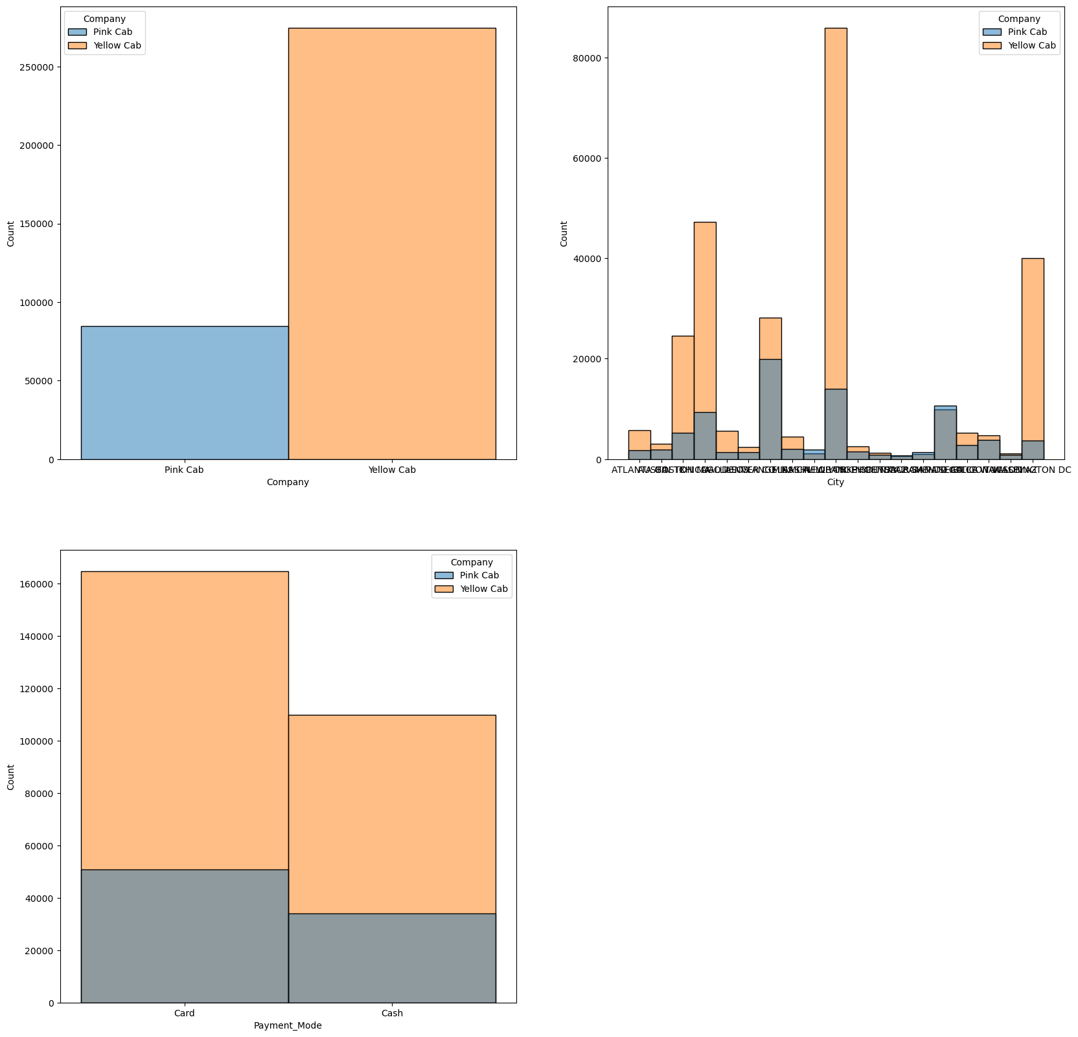
Question 4: What is the actual number of the yellow and pink cab users in the different cities with respect to the reported usage from each different city
The yellow cab company has the highest number of users compared to the pink cab company.
Generally Los Angeles, Chicago IL , Washington DC , Boston MA and New York NY have the highest number of users reported to use the yellow cabs.

Slide 11
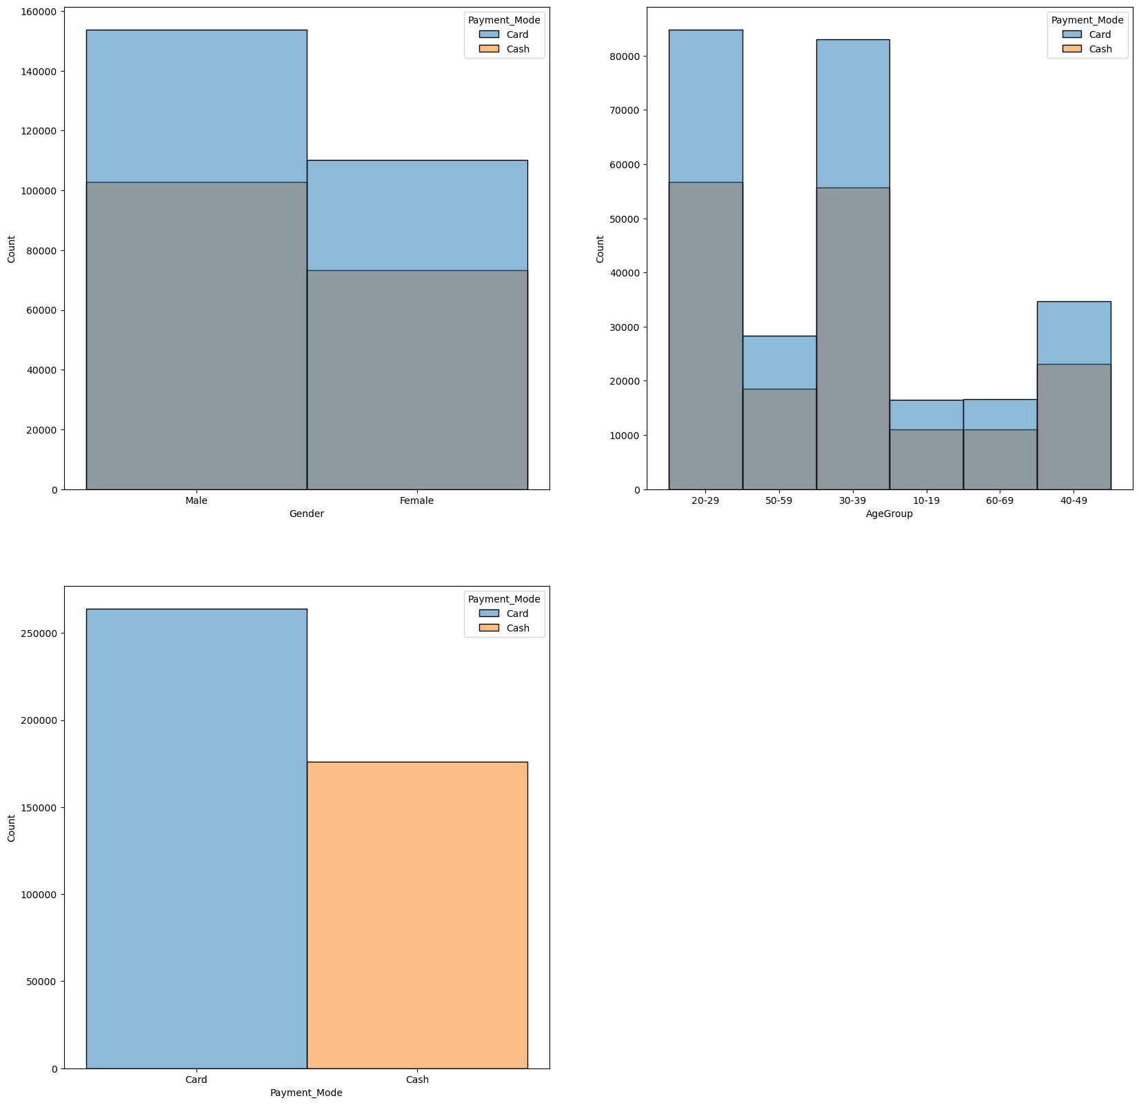
Question 5: What is the most preferred mode of payment between the male and female customers throughout all the cities?
59.98% of the customers paid using card compared to the 40% who used cash, 34.95% of the males and 25.03% of the females paid using card.
On average more users preferred using card than cash when paying for the yellow cab.
Payment mode | Female | Male | Income (USD/Month)
Card | 25.03352 | 34.95108 | 15085.4242
Cash | 16.65879 | 23.35662 | 15102.3121

Slide 12
Question 6: Which age group predominates overall across all the cities and what is the most preferred mode of payment amongst all the different age groups?
Age Group | Age | Female | Male | Card | Cash | Income (USD/Month)
 | count |  |  |  |  | mean
10-19 | 3112 | 11093 | 16420 | 16544 | 10969 | 14849.35701
20-29 | 15797 | 59913 | 81657 | 84823 | 56747 | 15068.13205
30-39 | 15579 | 57348 | 81440 | 83087 | 55701 | 14984.56274
40-49 | 6336 | 24141 | 33640 | 34624 | 23157 | 14992.38889
50-59 | 5229 | 19186 | 27641 | 28263 | 18564 | 15100.49761
60-69 | 3118 | 11806 | 15813 | 16650 | 10969 | 14975.74471
Many customers for the different cab companies are reported to be between 20 years to 39 years of age, mostly used card as the preferred method of payment for the cab.

Slide 13
Question 7: What is the correlation between kilometers travelled, price charged , cost of trip and profits from each trip?
 | KM Travelled | Price Charged | Cost of Trip | profits
KM Travelled | 1 | 0.835753 | 0.981848 | 0.462768
Price Charged | 0.835753 | 1 | 0.859812 | 0.864154
Cost of Trip | 0.981848 | 0.859812 | 1 | 0.486056
profits | 0.462768 | 0.864154 | 0.486056 | 1
46.27% of the reported profits are accounted for by the change in kilometers travelled
48.61% of the reported profit (extra income due to over charging) is attributed to the change in cost of trip
An increase in kilometers travelled affected the cost of trip and price to be charged for that trip

Slide 14
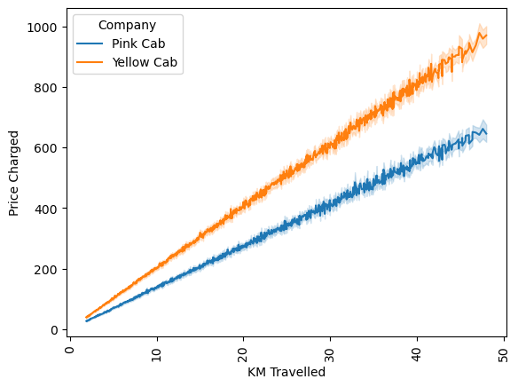
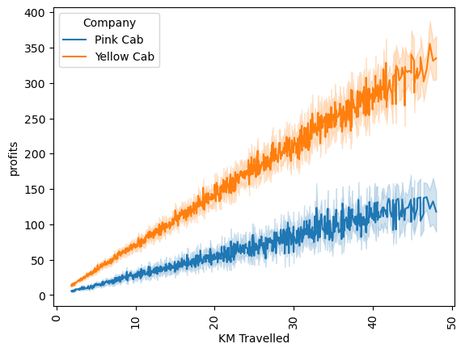
Question 8: How is the price charged per trip differ for the two cab companies and is it affected by number of kilometers travelled?
The yellow cab company charged a bit more for the same number of kilometers than the pink cab
Both cab companies have reported equal number of KM travelled, however in comparison to the amount of extra money earned per kilometers travelled, the yellow cab predominated over the pink cab
However, with increase in number of KM travelled, the higher the amount of extra cash earned for the yellow cab than the pink cab

Slide 15
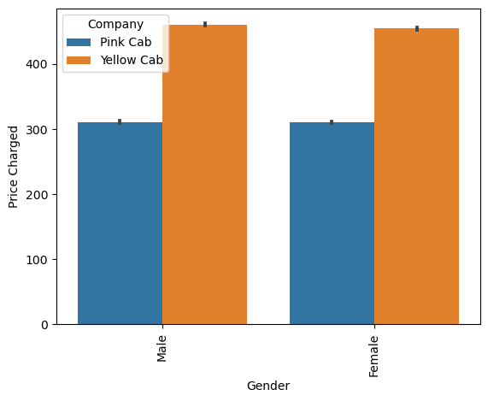
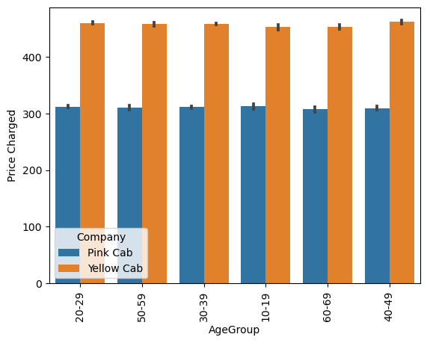
Question 9: Is the price charged for any cab company affected by gender and age group of the customer?
Both male and female customers paid extra when using the yellow cab as for the pink cab
All age groups were charged the same and all were charged the same for the yellow cab as it is for the pink cab
All customers regardless of gender and age were willing to pay price charged by the cab companies

Slide 16
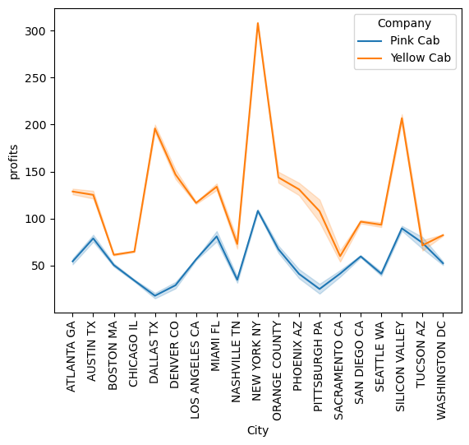
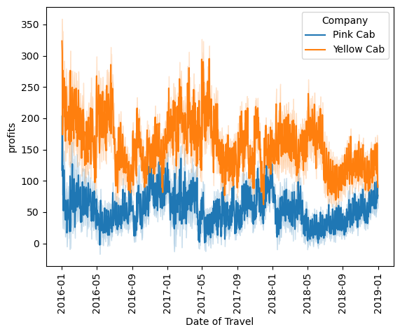
Question 9: Which cab company makes more extra income per trip over thr period of three years reported?
The yellow cab company predominates in the market share and consequently attains more profits over the pink cab
The yellow cab charged a little more than the pink cab therefore it earns extra in all cities reported for a period of three years.
In some major cities such as New York NY, Silicon valley, Dallas TX, the yellow cab earns extra money than the pink cab.

Slide 17
EDA summary
Descriptive analysis to calculate summary statistics for transaction amounts, customer demographics, and payment modes, as well as exploring temporal trends in transaction volumes and customer behavior from 31/01/2016 to 31/12/2018.
Customer profiling will involve segmenting customers based on demographic characteristics and analyzing behavior and payment modes to gain insights into customer segments.
Market analysis will evaluate the performance of two cab companies based on transaction data, market share, and customer retention rates, and analyze the distribution of cab users across US cities using City.csv data to identify market opportunities.
Correlation analysis will be conducted to identify relationships between variables influencing customer preferences, transaction behavior, and market dynamics.

Slide 18
Key takeaways and recommendations
The yellow cab company has a higher market share in terms of number of reported users in most major cities compared to the pink cab, therefore consequently makes more money
The yellow cab company is most preferred than the pink cab and this can be explained by the percentage usage in every city
Mostly customers between the ages of 20-39 years use cabs, this population accounts more on the number of reported users.
With the most preferred payment mode being card, this ensures more secure payment, more users of the yellow cab opted for the card payment.

Slide 19
Key takeaways and recommendations
The yellow cab charged extra for the same number of kilometers travelled than the pink cab, consequently the yellow cab makes more extra cash than the pink cab.
There has been consistent reported usage of the yellow cab for a period of three years, it still predominated over the pink cab in terms of market share and extra cash.
All customers regardless of gender and age were willing to pay price charged by the yellow cab company.
Generally Los Angeles, Chicago IL , Washington DC , Boston MA and New York NY have the highest number of users reported to use the yellow cabs and these offer great business opportunities and hotspots for customers

Slide 20
Recommendations
The yellow cab has more market share, higher percentage usage and higher number of users in most of the major and crowded cities in the USA.
It’s use is consistent throughout the year and over years with more reported users and extra cash than the pink cab.
Therefore, it’s a better investment option over the pink cab company.

Slide 21
The end
Thank You

